Slide 1
Proactive Privacy-Preserving Defense for
Federated Learning based Intrusion Detection System
With Homomorphic encryption and unlearning mechanism

Slide 2
GUIDED BY:
Dr. K. Kulothungan
Associate Professor,
Department of Information Science and Technology
LOGESH M S 2022115045 | VIJAY K G 2022115063 | JOTHIRUBAN M 2022115096 | SYED SHARAAFATH HASSAN S 20221151030

Slide 3
Overview
A secure way for Clients (Institutes) to learn together without sharing private data for training an Intrusion Detection System.
The System uses advanced encryption to protect information and actively stops hackers from corrupting the model.
It also lets us 'delete' specific user data when needed and accurately spots network attacks, ensuring a safe and reliable network for everyone.

Slide 4
Literature Survey
S no | Title of the Paper | Author and Year | Methods
1 | A Proactive Defense Against Model Poisoning Attacks in Federated Learning (RECESS) | Zhang et al. (2025) IEEE TRANSACTIONS ON DEPENDABLE AND SECURE COMPUTING,VOL.22 | Introduces "RECESS," a proactive defense framework. The server sends "Query Gradients" (Trap Vectors) to clients and verifies their response consistency using Cosine Similarity
2 | FedPHE: A Secure and Efficient Federated Learning via Packed Homomorphic Encryption | Li et al. (2025) IEEE TRANSACTIONS ON DEPENDABLE AND SECURE COMPUTING,VOL.22 | Uses CKKS Homomorphic Encryption with SIMD Packing to encrypt multiple gradients into a single vector. Implements a "Batching" technique to reduce ciphertext size.

Slide 5
Literature Survey
S no | Title of the Paper | Author and Year | Methods
3 | FedRecovery: Differentially Private Machine Unlearning for Federated Learning Frameworks | Zhang et al. (2023) IEEE TRANSACTIONS ON INFORMATION FORENSICS AND SECURITY, VOL. 18 | Develops a "Machine Unlearning" algorithm. It tracks historical updates and allows the server to mathematically subtract the influence of a specific client from the global model..
4 | Evaluating Federated Learning-Based Intrusion Detection Scheme for Next Generation Networks | Singh et al. (2024) IEEE TRANSACTIONS ON NETWORK AND SERVICE MANAGEMENT, VOL. 21, | Proposes a Federated IDS using deep learning on the CIC-IDS2017 dataset. Focuses on handling Class Imbalance (rare attacks vs normal traffic).

Slide 6
Problem Statement
Collaborative organizations fighting cyber threats face regulatory restrictions (e.g., GDPR).
Standard Federated Learning (FL) avoids raw data sharing but risks "Gradient Leakage," allowing mathematical reconstruction of sensitive data from shared model updates.
FL is also highly susceptible to Model Poisoning, where malicious data corrupts the global AI, which is hard to detect since the central server cannot inspect updates.
Existing defenses are reactive, blocking future attacks but unable to "unlearn" or reverse specific malicious contributions efficiently without complete model retraining.

Slide 7
Challenges
Implementing high-security encryption on AI models increases computation time significantly. The challenge is achieving Real-Time Intrusion Detection speeds while processing complex, encrypted vectors.
The system must distinguish between "Benign" and "Malicious" updates without ever seeing the data. This requires implementing complex Similarity Checks that operate blindly on encrypted inputs.
Real-world datasets (CIC-IDS2017) contain less than 1% attack traffic. Training a decentralized model to detect these rare events without producing high false positives requires specialized Local Data Sampling techniques.

Slide 8
Objectives
To build a Hybrid CNN-LSTM Neural Network that effectively detects modern cyberattacks (like DDoS and Botnets) across distributed clients.
To integrate Packed Homomorphic Encryption (FedPHE) ensuring that the central server aggregates model updates without ever accessing the raw gradients or client data.
To engineer a server-side defense module that uses "Trap Gradients" and encrypted similarity checks to identify and block malicious nodes before their updates are fully merged.
To implement a remediation module that allows the system to subtract the encrypted contributions of a detected attacker from the global model, ensuring the AI can recover itself from past poisoning.

Slide 9
Scope
Simulates a collaborative intrusion detection network using the CIC-IDS2017 dataset to detect anomalies like DDoS and Botnets across disparate, independent client nodes.
Implements Packed Homomorphic Encryption (FedPHE) to ensure Blind Aggregation allowing the server to combine model updates without ever decrypting or seeing the underlying values.
Specifically addresses Data Poisoning Attacks (Label Flipping) where compromised internal nodes attempt to degrade the global model's accuracy.
Develops a full-stack platform featuring a Hybrid CNN-LSTM classification model, a Unlearning Module, and a Real-time Trust Dashboard for monitoring node integrity.

Slide 10
Architecture Diagram

Slide 11
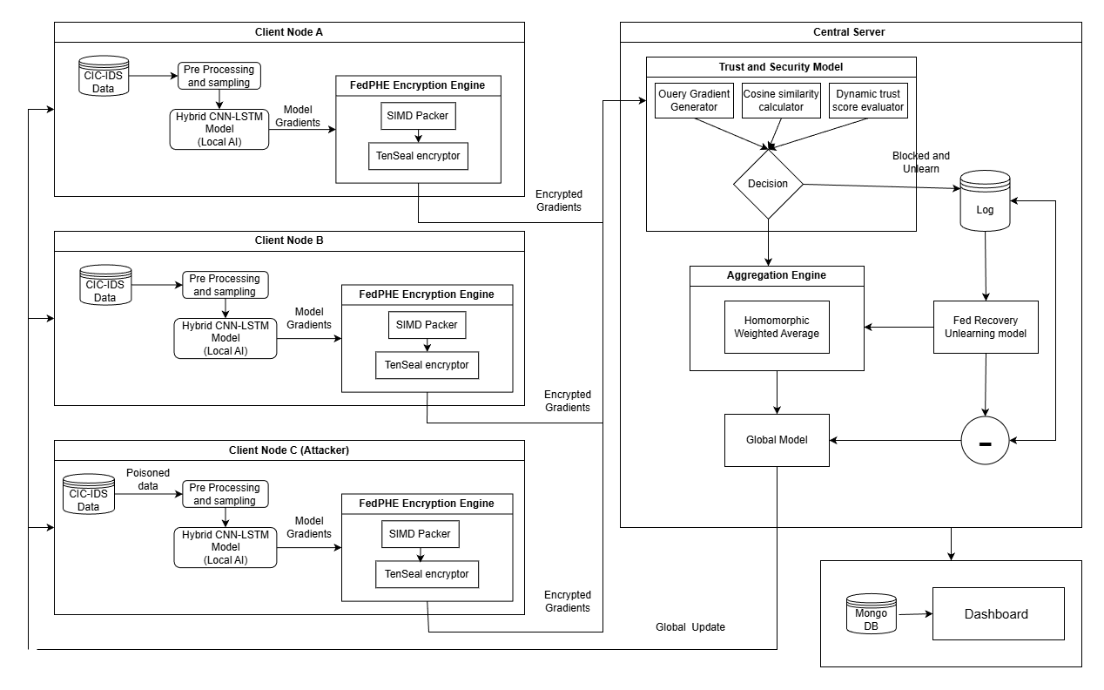

Slide 12
TOOLS & TECHNOLOGIES

Slide 13
Python: The primary language used across all modules for implementing the FL server, client logic, and cryptographic protocols.
PyTorch: The unified framework used in all the papers for building and training the neural networks.
Torchvision: Essential for loading and preprocessing the image datasets mentioned in the studies
TenSEAL: A library for Homomorphic Encryption operations on tensors

Slide 14
TensorBoard: Used for tracking model convergence, visualizing loss curves, and monitoring training metrics in real-time.
CUDA Toolkit: Required for enabling GPU acceleration on NVIDIA hardware
Matplotlib: Recommended for generating the static performance graphs
NumPy: Essential for matrix manipulations

Slide 15
REFERENCES

Slide 16
G. Singh, K. Sood, P. Rajalakshmi, D. D. N. Nguyen and Y. Xiang, "Evaluating Federated Learning-Based Intrusion Detection Scheme for Next Generation Networks," in IEEE Transactions on Network and Service Management, vol. 21, no. 4, pp. 4816-4829, Aug. 2024
Y. Li et al., "FedPHE: A Secure and Efficient Federated Learning via Packed Homomorphic Encryption," in IEEE Transactions on Dependable and Secure Computing, vol. 22, no. 5, pp. 5448-5463, Sept.-Oct. 2025
H. Yan et al., "A Proactive Defense Against Model Poisoning Attacks in Federated Learning," in IEEE Transactions on Dependable and Secure Computing, vol. 22, no. 4, pp. 3529-3543, July-Aug. 2025
L. Zhang, T. Zhu, H. Zhang, P. Xiong and W. Zhou, "FedRecovery: Differentially Private Machine Unlearning for Federated Learning Frameworks," in IEEE Transactions on Information Forensics and Security, vol. 18, pp. 4732-4746, 2023

Slide 17
THANK YOU

